Slide 1
Version Control
Methods and Technologies of Professional Programming Slides: Prof. Dr.-Ing. Peter Hertkorn
Dr. Robin Braun | Senior Consultant

Slide 2
Overview
Version Control
Git
Basis Workflow
Branches
Merging Strategies
Branching Strategies

Slide 3
Motivation
Clean Code Developer Practice
Version control systems register changes to documents or data
Changes are recorded
Individual project states are archived
Possibility of restoring old states of design
Takes away the fear of accidentally breaking something
Collaborative Development
Parallel work on different versions
Simultaneous development on different aspects via different developers
Possibility of separation in different development branches

Slide 4
Version Control
System that records changes to a data set or multiple data sets over time
Earlier versions of the data can always be restored a later point in time
1972 Marc Rochkind: First software for version control (SCCS – Source Code Control System)
Addressed topics: memory capacity , recording of data/information, transferability, version history
Today: Extended version control through aspects of coordination and collaboration
Notes:
Gromer, AES
aus: Rochkind, 1975: The source code control system (IEEE Transactions on SE)

Slide 5
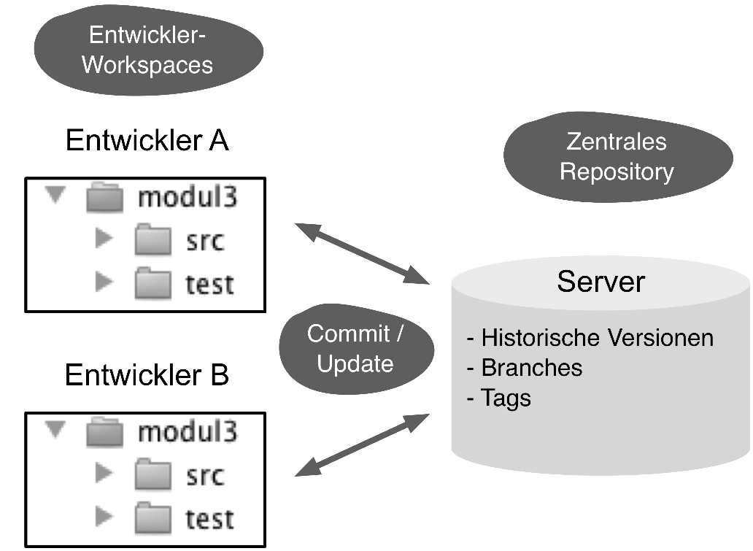
Central Version Control
Central server saves current and past versions of all branches and tags
Developers have a workplace with all of the project data
Changes are sent to the server via Commit
Changes that are made by other developers are fetched via an update from the server
All projects are stored in a shared repository
Developer
Workspaces
Developer A
Central
Repository
Past versions
Branches
Tags
Developer B
Preißel and Stachmann, 2019
Notes:
PreißelStachmann2019, S. 1

Slide 6
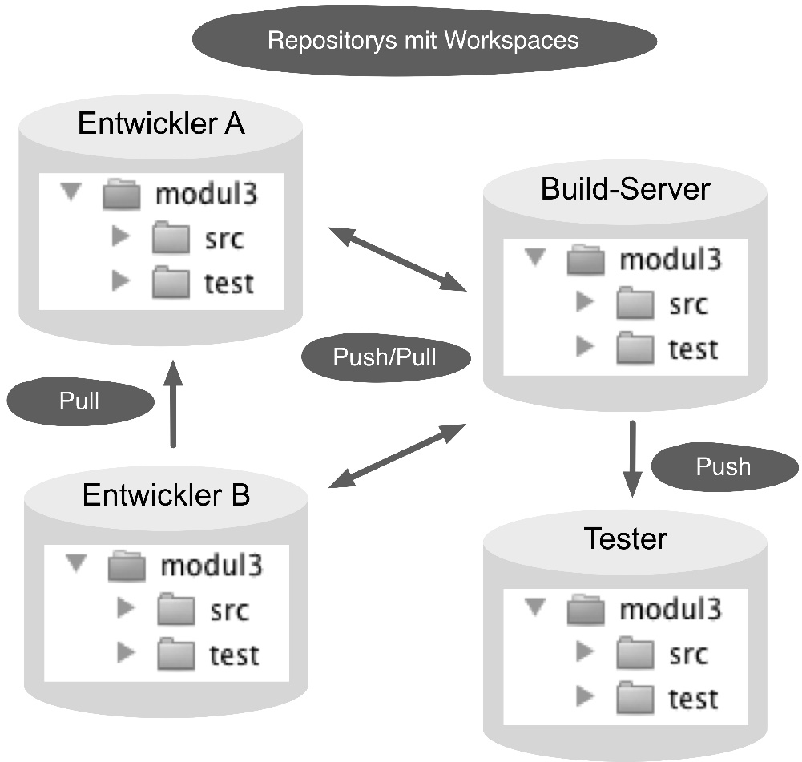
Decentralized Version Control
No separation between developer and server environment
Developers have workspaces where data as well as a local repository with all versions, branches, and tags can be found
Changes are established in the local repository via Commit
Exchange with other repositories using push/pull commands
All repositories are equal technically
Normally each project maintains its own repository (Exception: Monorepo)
Repositories with Workspaces
Developer A
Developer B
Preißel and Stachmann, 2019
Notes:
PreißelStachmann2019, S. 2

Slide 7
Comparison of Central and Decentral Version Control
Central Version Control
Path-based access authorization for different areas of a project
All work is bundled in one place
Structure of empty directory is recorded
Decentral Version Control
High Performance
Efficient work methods
Offline capability
Flexible development process
Backup
Maintainability
Before DVCS, the guiding principle was "Pray to God that you don't have to get into branching and merging. And if you do, at least beg Him to let it be very, very simple."
Notes:
PreißelStachmann2019, S.3
Hohe Performance: Fast alle Operationen werden ohne Netzwerkzugriff lokal durchgeführt.
Efﬁziente Arbeitsweisen: Entwickler können lokale Branches benutzen, um schnell zwischen verschiedenen Aufgaben zu wechseln.
Ofﬂine-Fähigkeit: Entwickler können ohne Serververbindung Commits durchführen, Branches anlegen, Versionen taggen etc. und diese erst später übertragen.
Flexibilität der Entwicklungsprozesse: In Teams und Unternehmen können spezielle Repositorys angelegt werden, um mit anderen Abteilungen, z. B. den Testern, zu kommunizieren. Änderungen werden einfach durch ein Push in dieses Repository freigegeben.
Backup: Jeder Entwickler hat eine Kopie des Repositorys mit einer vollständigen Historie. Somit ist die Wahrscheinlichkeit minimal, durch einen Serverausfall Daten zu verlieren.
Wartbarkeit: Knifﬂige Umstrukturierungen kann man zunächst auf einer Kopie des Repositorys erproben, bevor man sie in das OriginalRepository überträgt.
Zitat aus: https://stackoverflow.com/questions/4415127/git-vs-team-foundation-server

Slide 8
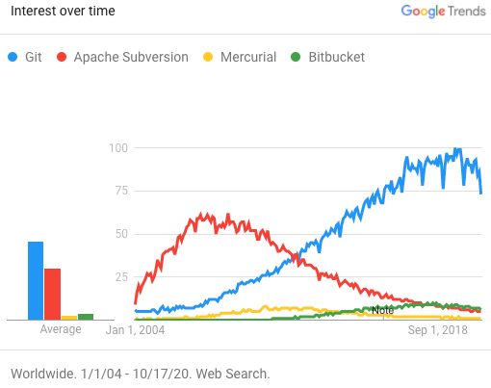
Git
System for distributed version control
Goals
Coordinate work for multiple programming
Record changes in data
Velocity and data integrity
Support distributed, non-linear workflow
Traits
Create snapshots of data over the course of time
Restore earlier versions of data from snapshots
Work parallel on various versions of data
History
April 2005: Linus Torvalds implements Git because the BitKeeper software used for the Linux kernel changed its license and could no longer be used free of charge
Notes:
PreißelStachmann2017, vii
https://en.wikipedia.org/wiki/Git

Slide 9
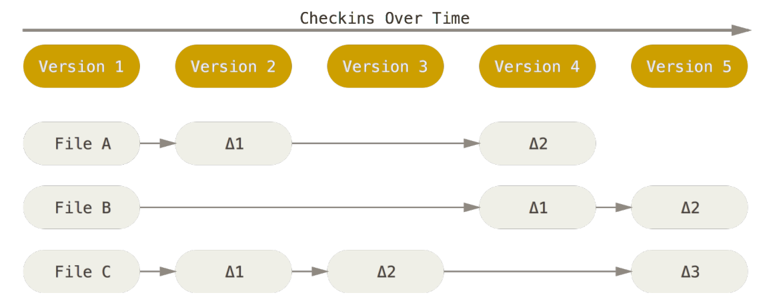
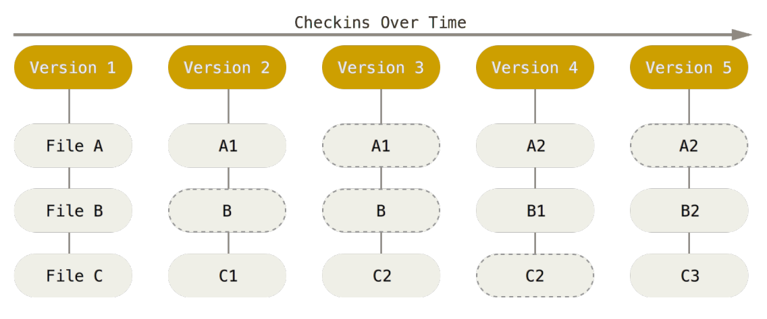
Snapshots instead of changes
Many other systems save changes related to individual data. In contrast, Git deals with the data within the project as a snapshot of a differentiated data system
Subversion Git

Slide 10
Reasons for Using Git
Work with branches: parallel development strands
Flexibility in Workflow: customizable for different scenarios
Contributions to Open-Source-Projects: lower hurdles for developers
Comprehensible origin of the code
Performance: great for big projects
Robust against mistakes and attacks: decentral repositories, test numbers
Offline and multi-site development: decentral architecture
Administrable: easy to use and administer
Open-Source-Community: extensive ecosystem
Extendibility: comfortable commands for application, elementary commands for direct access to the repository
Notes:
PreißelStachmann2017, vii

Slide 11
Repository
Core: efficient data storage space of the project in the form of objects for:
Data content (Blobs):
Texts or binary data
Saved independently from the data name
Directory structure (Trees):
Lists with all contained data and subdirectories
Data mapping/Blob, Subdirectory/Tree
Version History(Commits):
Commit: the whole state of the project restorable
Snapshot of the directory tree with all data content
Autor, time, comments, previous versions

Slide 12
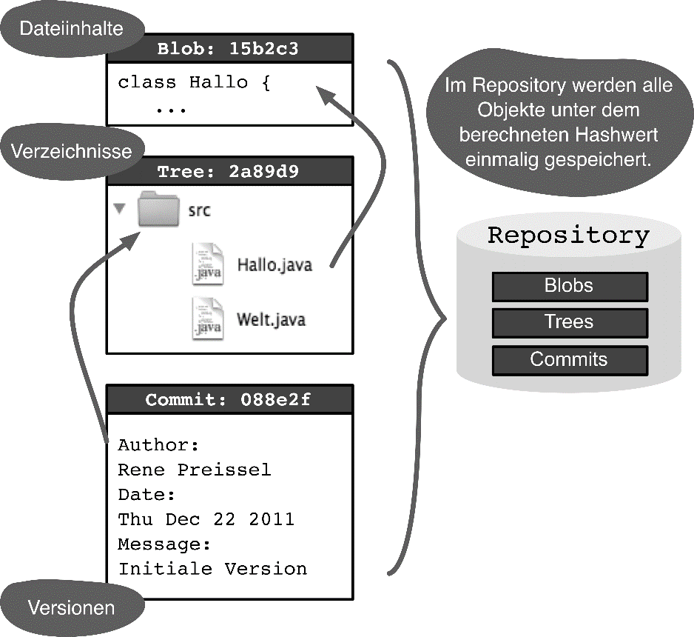
Hash Value
Hexadecimal values for the objects: 40 characters
Data and directories
Reference between objects
Key to finding data again
Commit
Version number of Git (all project data)
Check whether the version number is contained in a local repository
Advantages
High performance
Redundancy-free saving
Decentral version numbers
Efficient balance between repositories
Object integrity
Automatic recognition of name changes
Data content
All objects in a repository are saved once under the calculated hash value
Directories
Versions
Preißel and Stachmann, 2019
Notes:
PreißelStachmann2019, S. 4f.
Hohe Performance: Der Zugriff auf Daten über den Hashwert geht sehr schnell.
Redundanzfreie Speicherung: Identische Dateiinhalte müssen nur einmal abgelegt werden.
Dezentrale Versionsnummern: Da sich die Hashwerte aus den Inhalten der Dateien, dem Autor und dem Zeitpunkt berechnen, können Versionen auch »ofﬂine« erzeugt werden, ohne dass es später zu Konﬂikten kommt.
Efﬁzienter Abgleich zwischen Repositorys: Werden Commits von einem Repository in ein anderes Repository übertragen, müssen nur die noch nicht vorhandenen Objekte kopiert werden. Das Erkennen, ob ein Objekt bereits vorhanden ist, ist dank der Hashwerte sehr performant.
Integrität der Objekte: Der Hashwert wird aus dem Inhalt der Objekte berechnet. Man kann Git jederzeit prüfen lassen, ob Daten und Hashwerte zueinander passen. Unabsichtliche Veränderungen oder böswillige Manipulationen der Daten werden so erkannt.
Automatische Erkennung von Umbenennungen: Werden Dateien umbenannt, wird das automatisch erkannt, da sich der Hashwert des Inhalts nicht ändert. Es sind somit keine speziellen Befehle zum Umbenennen und Verschieben notwendig.
PreißelStachmann2019, S.33 f.
Hash wird aus Inhalt der Dateien und den Metadaten (Autor, Commit-Zeitpunkt) errechnet
Berechnung kann lokal erfolgen
Wahrscheinlichkeit für gleichen Hashwert bei unterschiedlichen Änderungen ist extrem gering
Dient als Prüfsumme -> Integritätsprüfung des Repositorys

Slide 13
Special Repositories
Blessed Repository For the creation of official releases
Shared Repository Serves the exchange between developers in the team
Workflow Repository Only changes that have achieved a certain status in workflow (e.g. successful review)
Fork Repository
Decoupling from the main development
Experimental development
Notes:
PreißelStachmann2019, S. 3

Slide 14
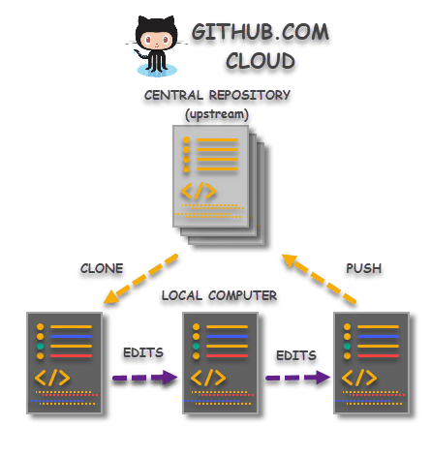
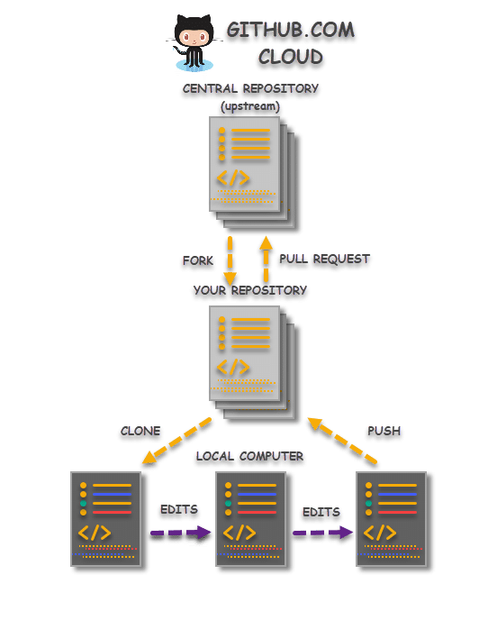
Creating a repository
Local Repository Existing directory Git Repository
Existing Repository
Repository cloning Clone, changes, Push
Creating fork
Copy of a repository
Often in Open-Source Projects when there is no authorized access to Push
Fork, Clone, Changes, Push, Pull Request
Notes:
https://www.toolsqa.com/git/difference-between-git-clone-and-git-fork/
Übungsaufgabe
Preißel S. 12, GitHub
Fork von Beispiel-Repo
Klon von Fork

Slide 15
Commit
Includes all files of a project
stored as a version in a repository
A copy of each file managed in the project is stored in the repository
Access authorizations per file are saved, but not the modification date
HEAD commit: Commit that is currently active in the workspace
Viewed as:
Frozen version status
Quantity of changes to the predecessor (diff, changeset)
Checkout: Restoring a version from the repository
Notes:
PreißelStachmann2019, S. 31 ff
S.32: Änderungszeitstempel wird beim Checkout auf die aktuelle Zeit gesetzt (Build Tools würden sonst bei älteren Dateien nicht getriggert)

Slide 16
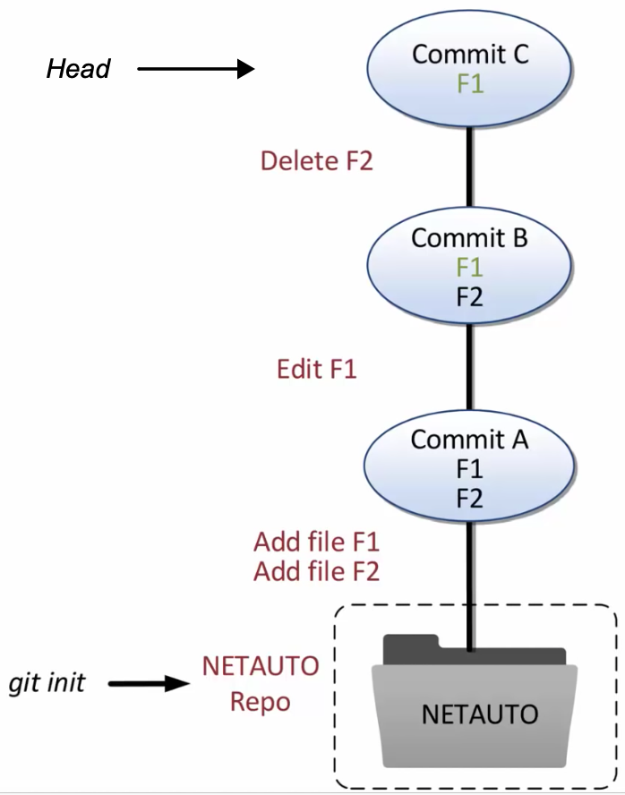
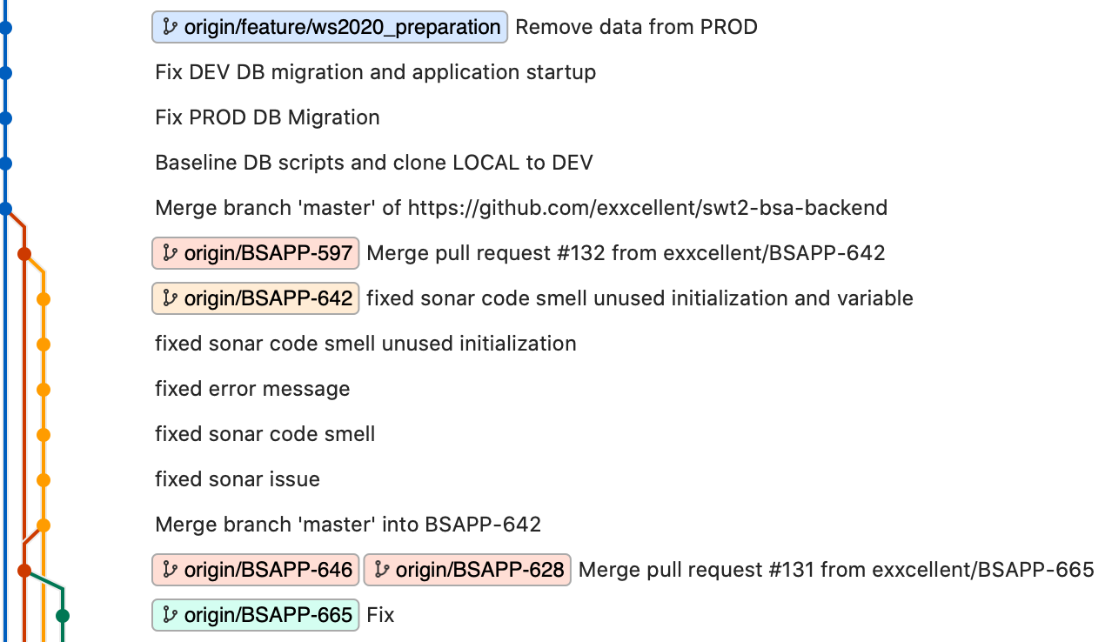
Commit Graph
Notes:
https://www.youtube.com/watch?v=uR6G2v_WsRA&t=63s

Slide 17
Configuration
The user’s name, email, and timestamp is saved with each commit
Information can be found in the Git configuration files
System configuration: Option --system (/etc/gitconfig)
Global configuration (user specific): Option –-global (~/.gitconfig)
Configuration in the repository: Option --local (.git/config)
The specific configurations overwrite the general ones
Notes:
https://git-scm.com/book/en/v2/Customizing-Git-Git-Configuration

Slide 18
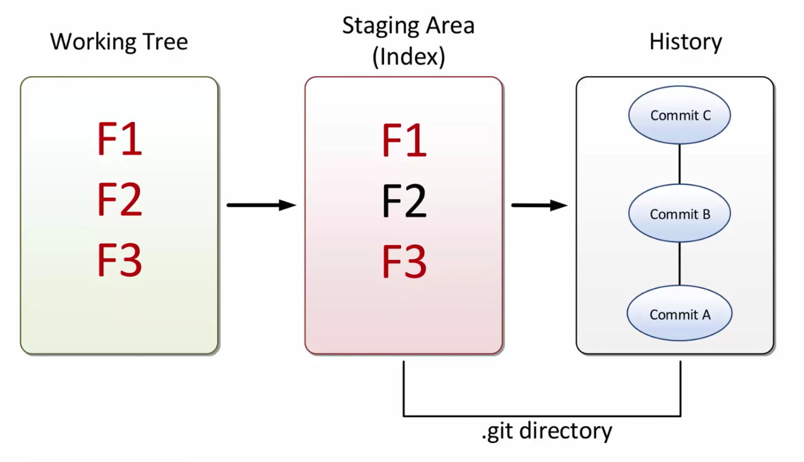
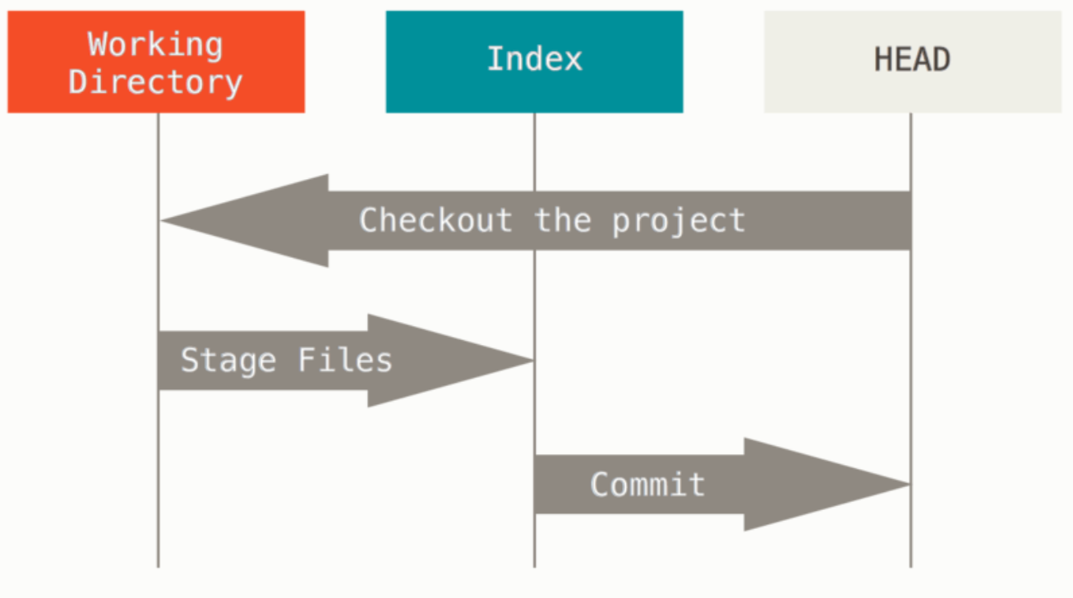
Areas
Notes:
https://www.youtube.com/watch?v=uR6G2v_WsRA&t=63s
https://git-scm.com/book/en/v2/Git-Tools-Reset-Demystified

Slide 19
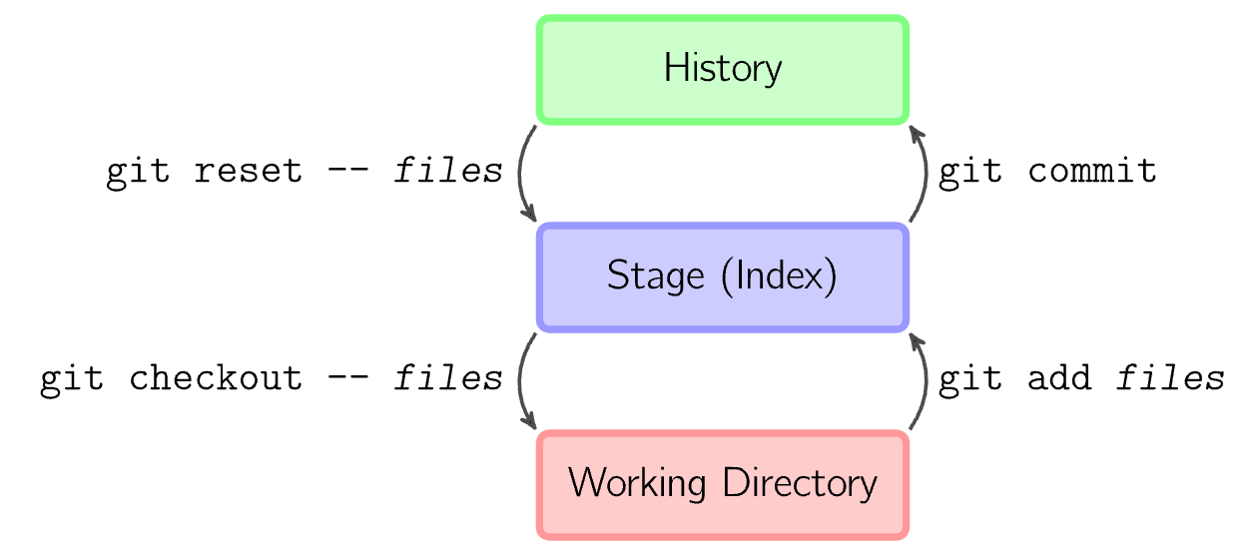
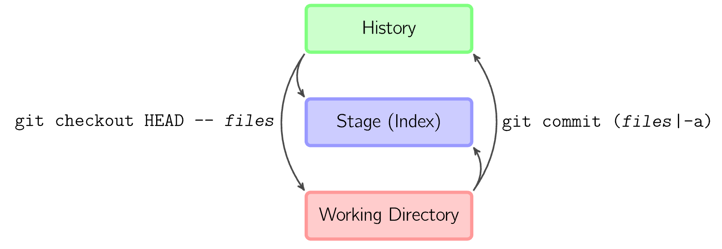
Basis Workflow - 1
Save changes in the project archive
Copy data from the work directory in the index git add <Data>
Save index snapshot in the project archive git commit
Load data from the project archive
Copy data from Commit to the index git reset -- <Data> All data: git reset
Copy data from the index to the work directory git checkout -- Data
Skip Index
Notes:
https://marklodato.github.io/visual-git-guide/index-de.html
Workflow darstellen
Übungsaufgabe
Preißel S.11 ff.
Änderungen, Add, Status, Commit, Historie, Log
Pull
Push, Bare-Repository
Preißel S.21: Begriffe des Basis-Workflows
Stage-Bereich (S. 44)

Slide 20
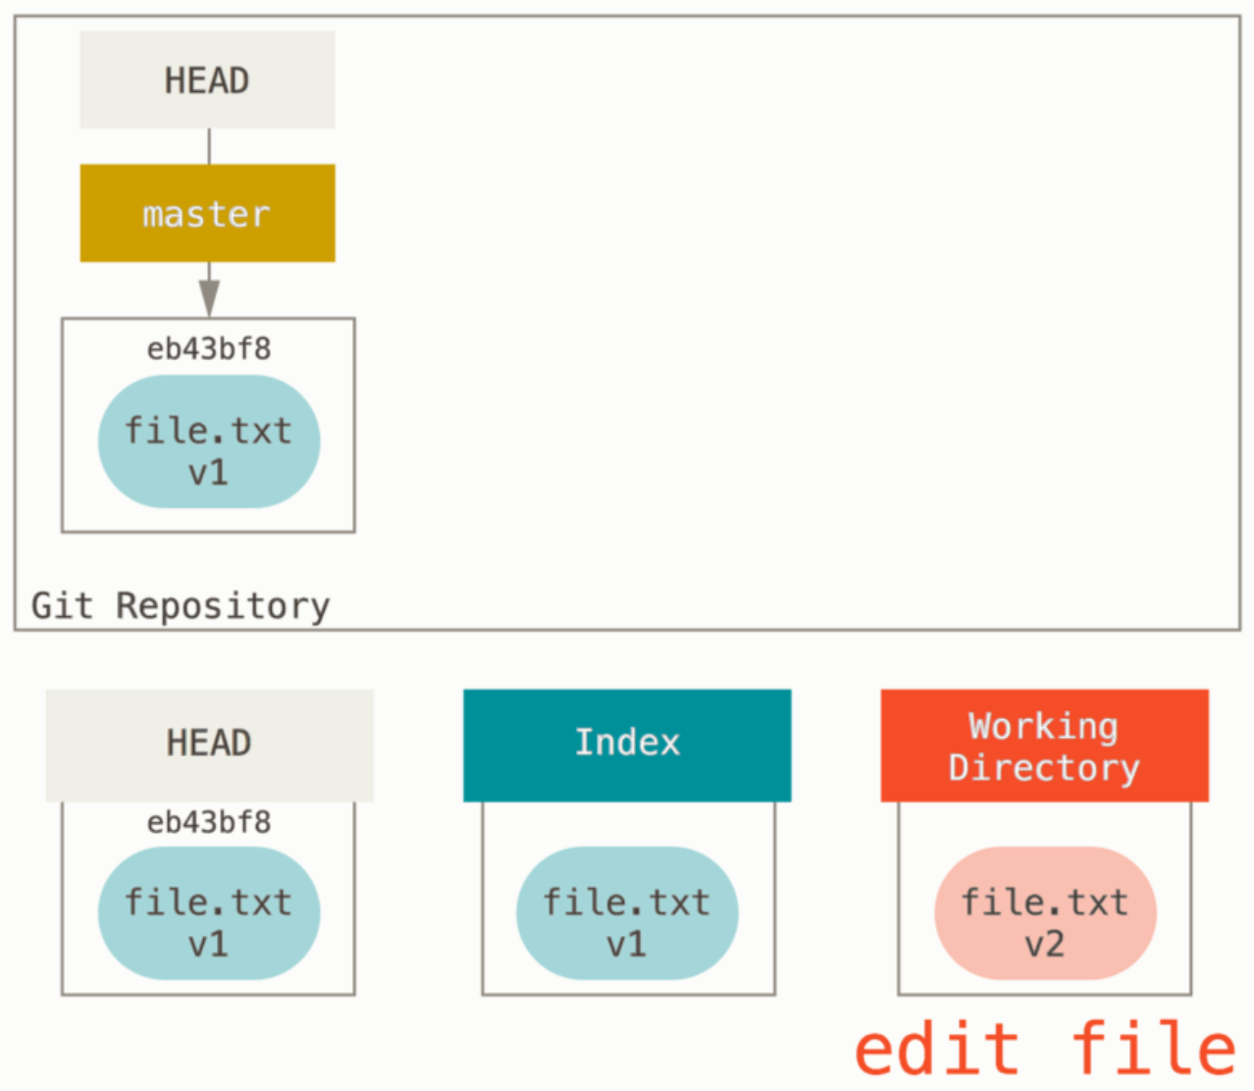
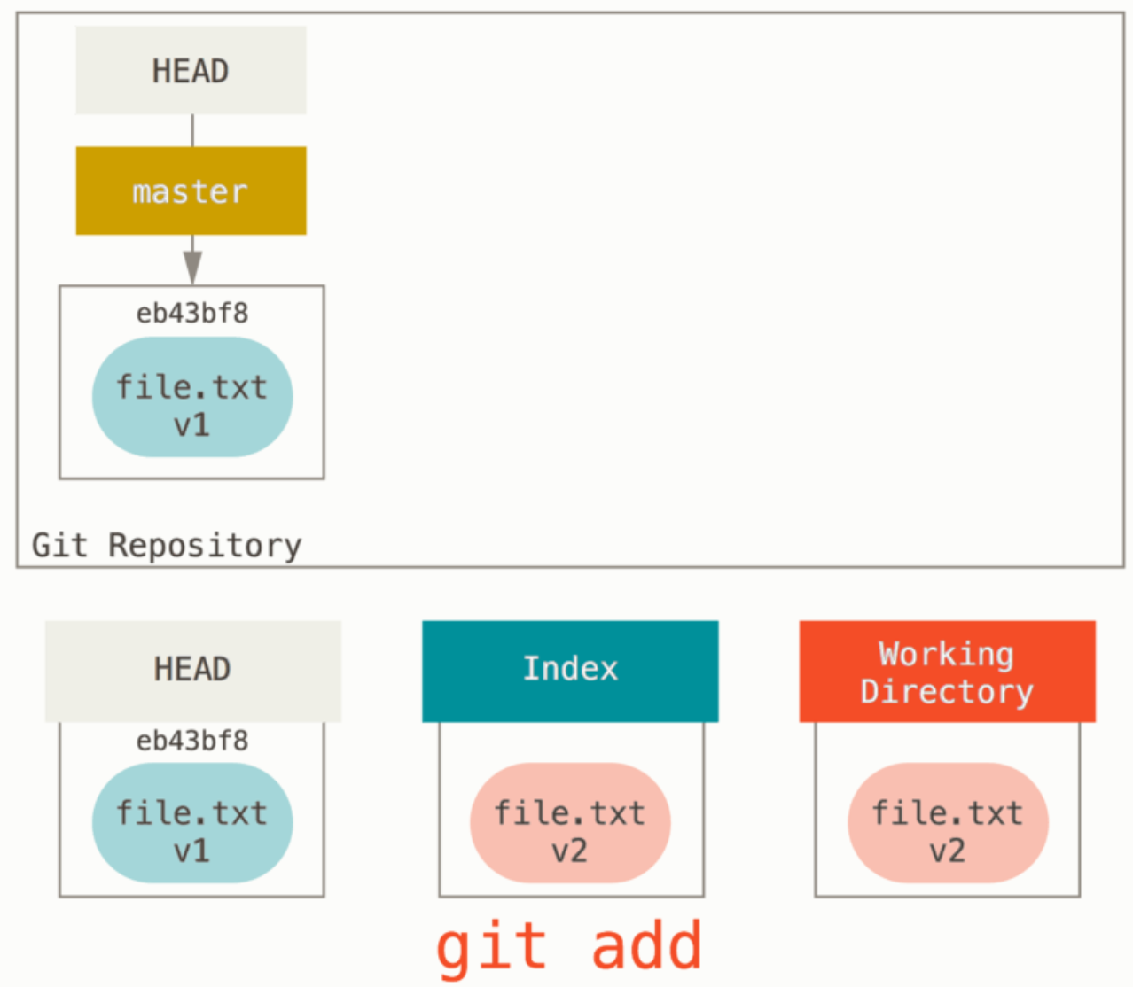
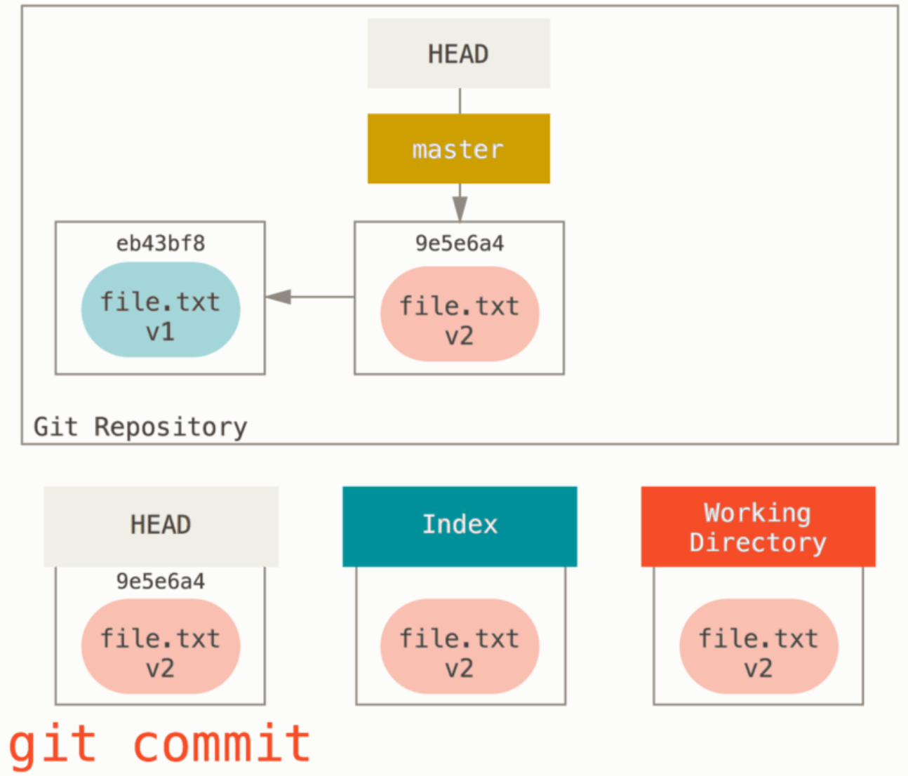
Basis Workflow - 2
Notes:
https://git-scm.com/book/en/v2/Git-Tools-Reset-Demystified

Slide 21
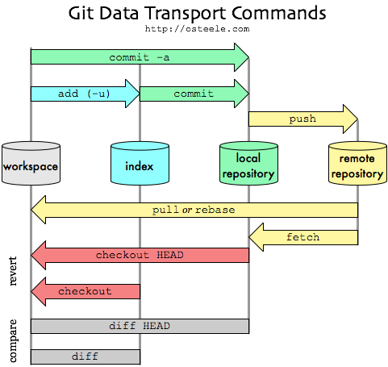
Transfer between Repositories
Notes:
http://blog.osteele.com/posts/2008/05/my-git-workflow/
nach: https://medium.com/@talgoldfus/better-understanding-gits-work-flow-in-order-to-properly-deal-with-merge-conflicts-part-i-760a366fc997

Slide 22
Branches
Enable parallel development
Reasons:
Multiple developers can work independently from each other on the same project
Bug fixes on older versions must be created and delivered
Multiple features should be developed parallel and only later be integrated
Software should be stabilized for a release, while the next version is being worked on
Branches create branches in the commit graph
There is always only one active branch that is continued during a commit
Notes:
PreißelStachmann2017, 59

Slide 23
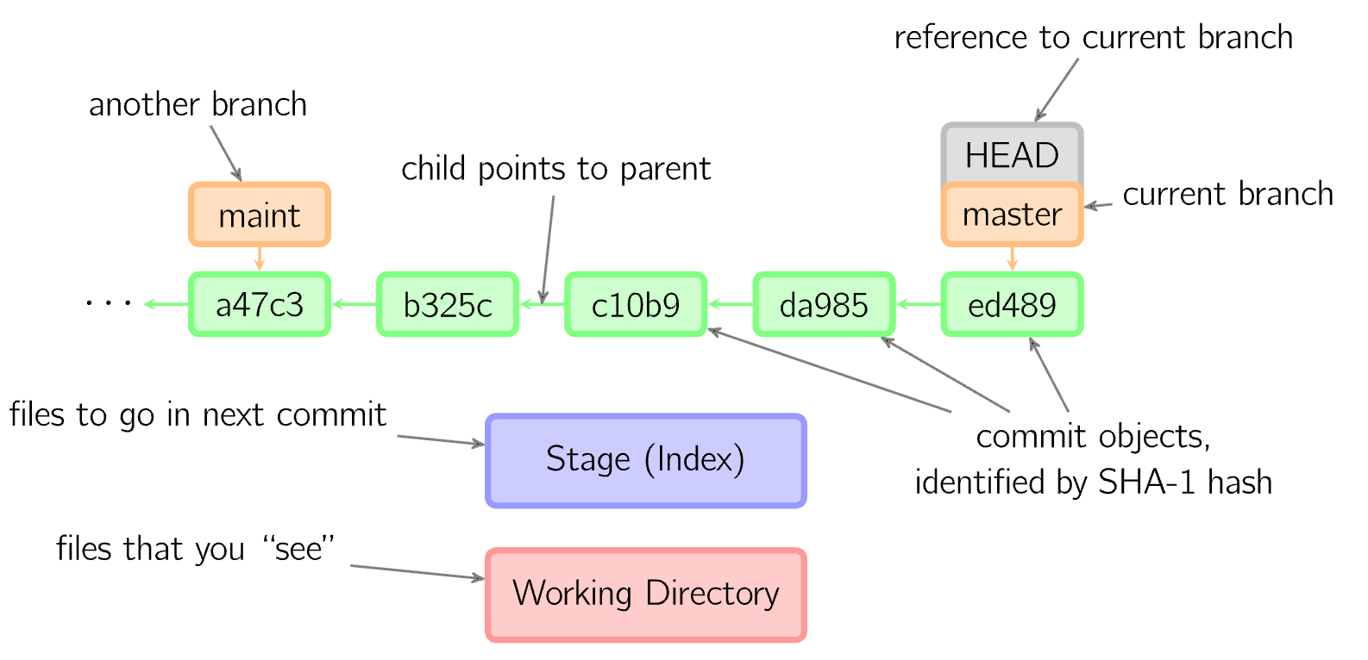
Overview

Slide 24
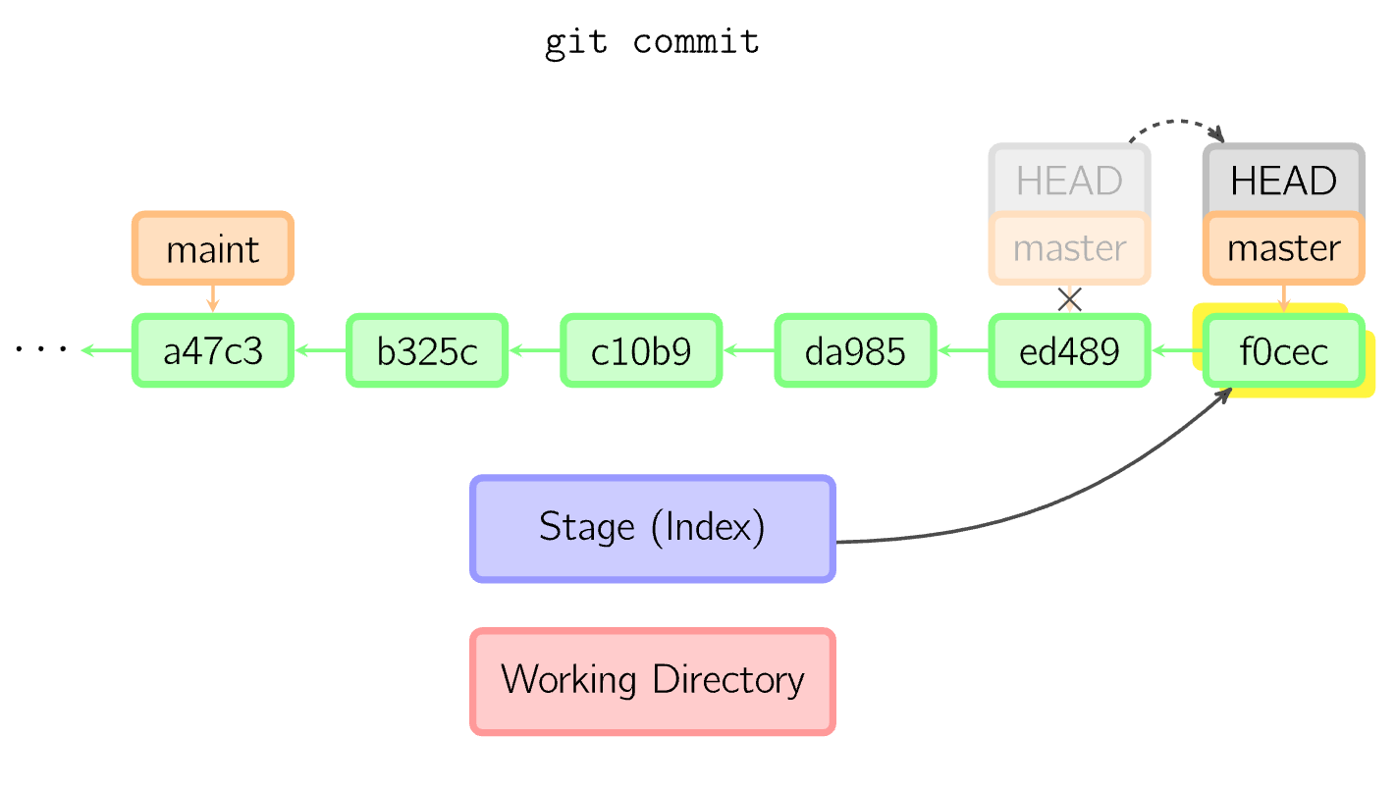
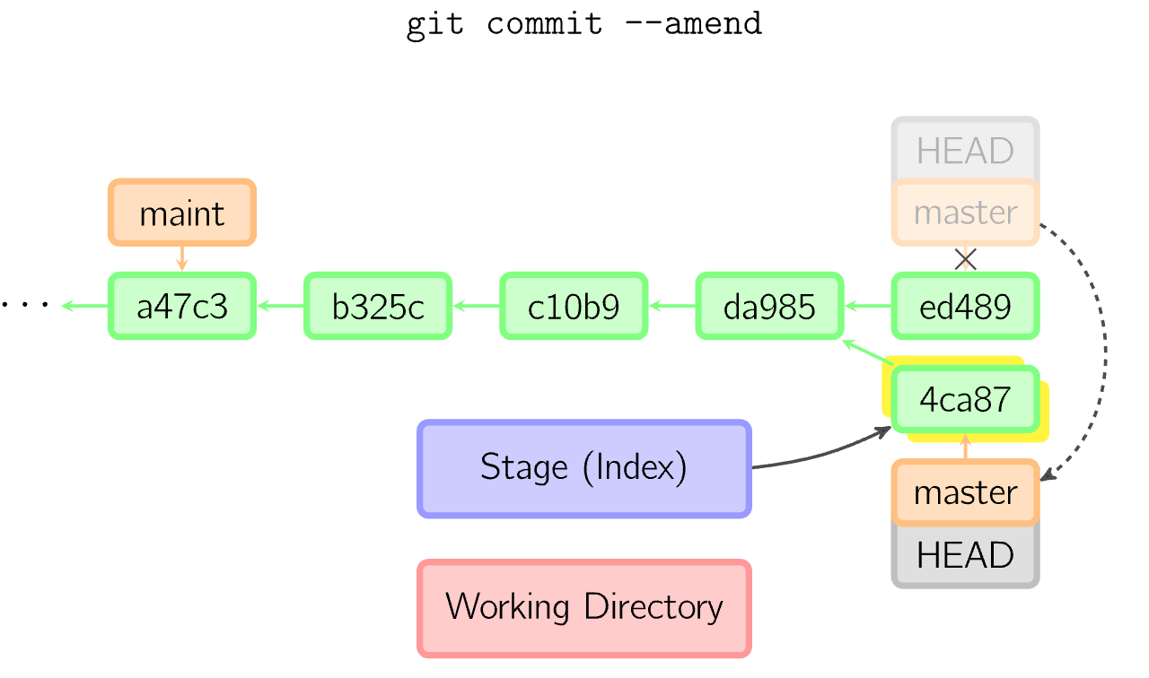
Applying changes in a new commit
git commit creates a new commit object with the data from the index
Deals with new data and deletions
Exception: data that is registered in .gitignore
The option--amend creates a new commit with the same predecessor
Notes:
PreißelStachmann2019, S.32
https://marklodato.github.io/visual-git-guide/index-de.html
- Der Vorgänger wird verworfen, wenn nichts mehr auf ihn verweist

Slide 25
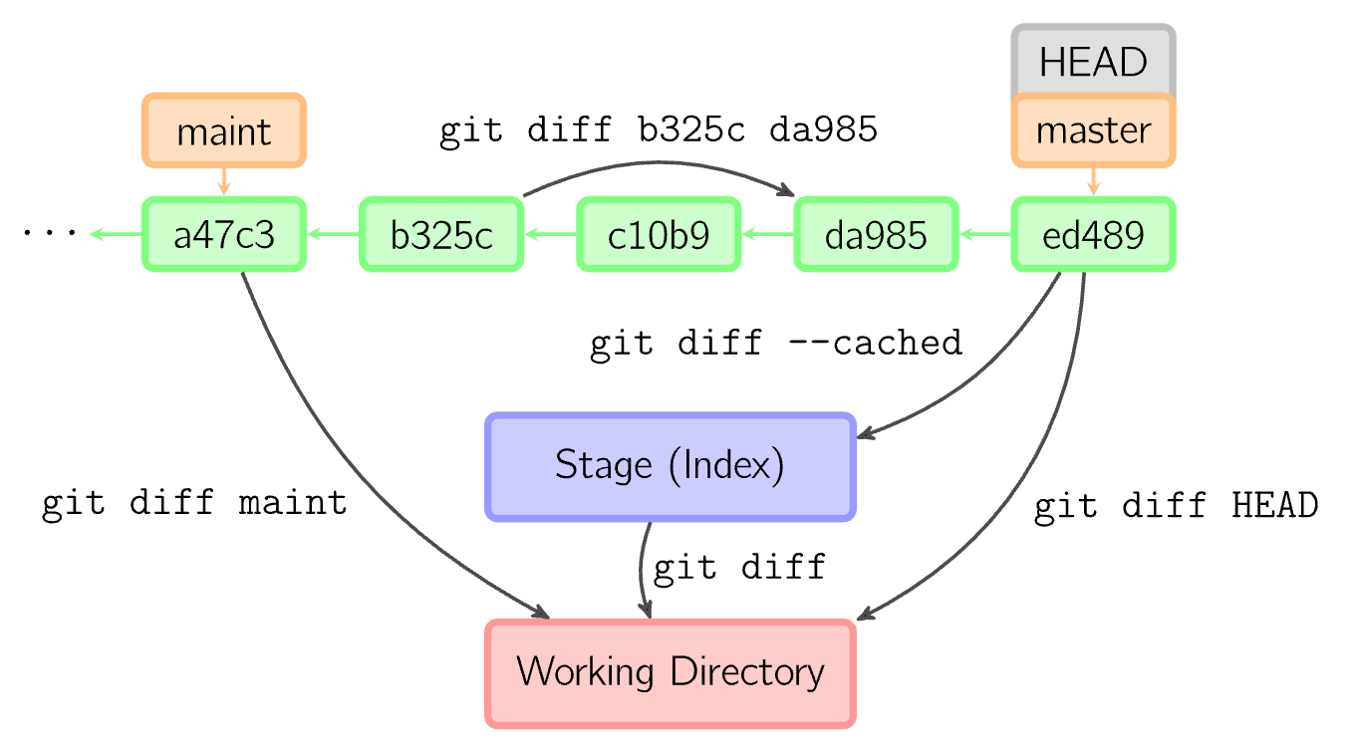
Differences between commits

Slide 26
Navigation via Commits
Parent-Commit of HEAD: git show HEAD~ or HEAD~1
Parent of the Parent of HEAD: git show HEAD~~ or HEAD~2
First ancestor of a merge: git show <Commit ID>^1
Second ancestor of a merge: git show <Commit ID>^2
Git records local changes on branches and on HEAD-Commit in Reflog:
Previous state of HEAD: git show HEAD@{1}
Previous state of master: git show master@{2}
Notes:
PreißelStachmann2019, 40

Slide 27
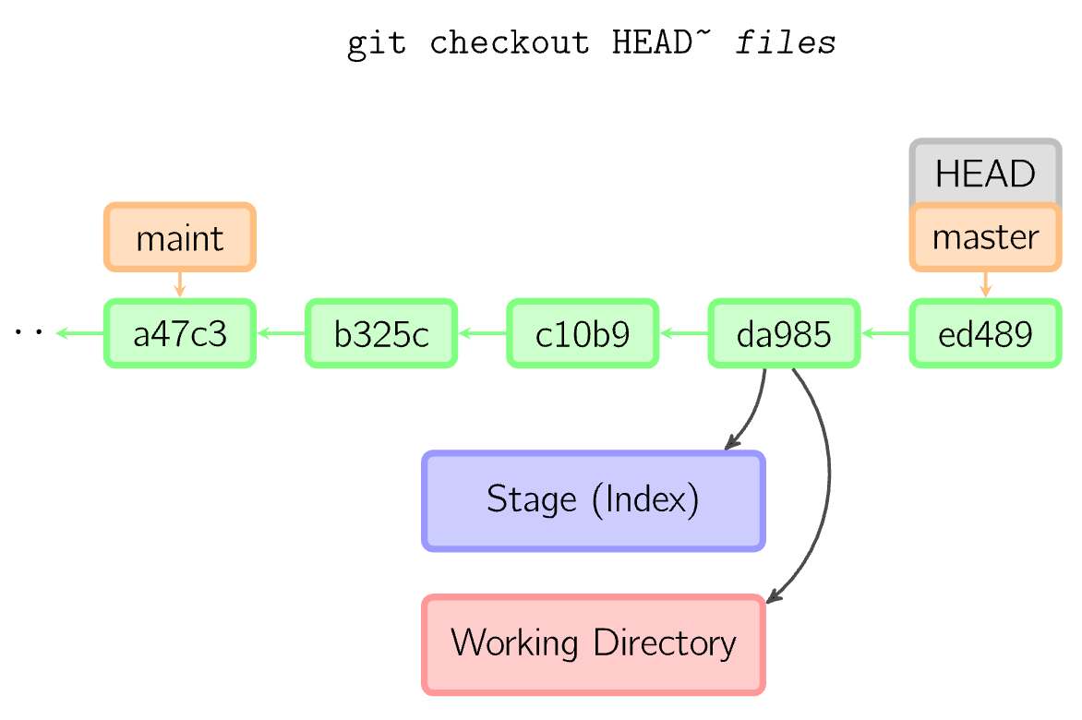
Loading data from the project archive - 1
git checkout copies data from the project archive or index into the work directory
Optionally, the branch can be changed
If file names are specified, these files are copied from the given commit to the index and the working directory
Without a commit-name, the data will be copied from the index

Slide 28
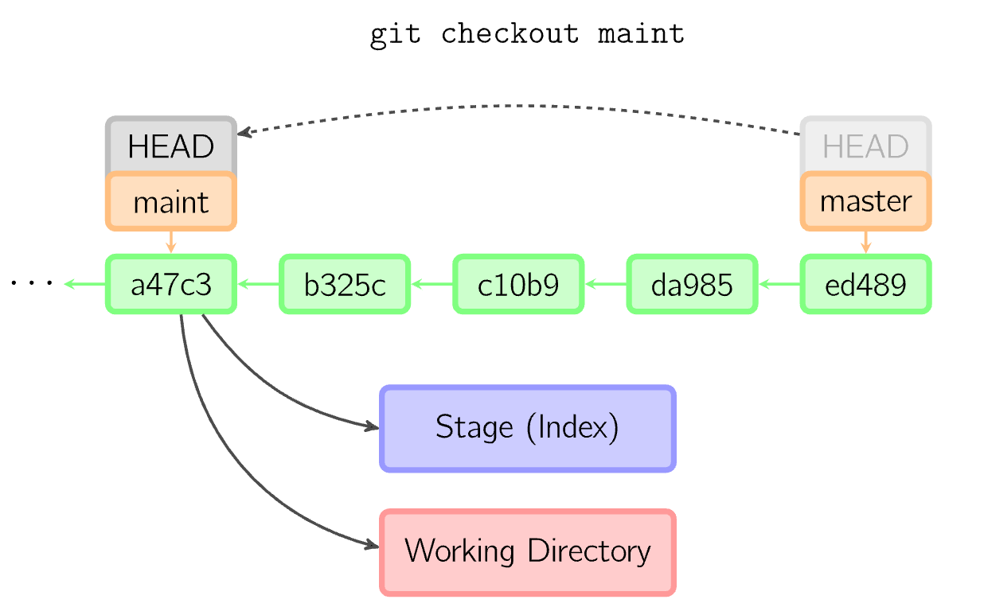
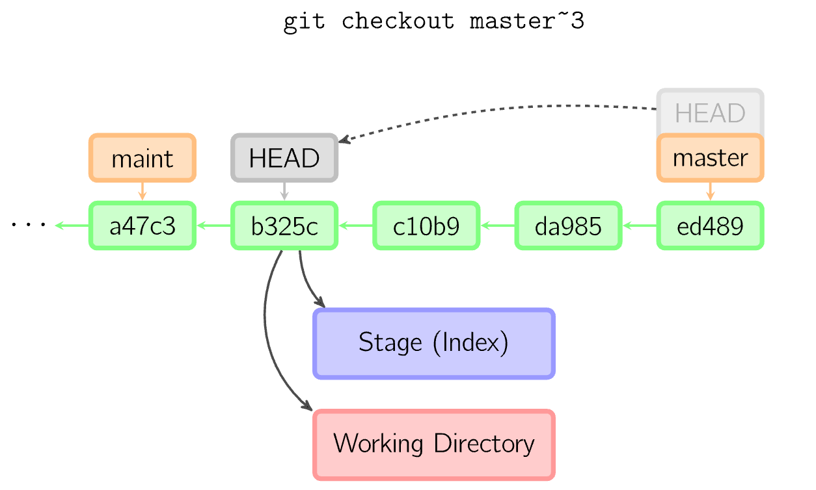
Loading data from the project archive - 2
No specification of data names
If a local branch is specified, the HEAD reference is set to this branch. The files in the index and in the working directory then correspond to the files of this branch.
If the specified reference is not a local branch (e.g. a tag, remote branch or commit), you will receive a “detached HEAD” - an anonymous branch.

Slide 29
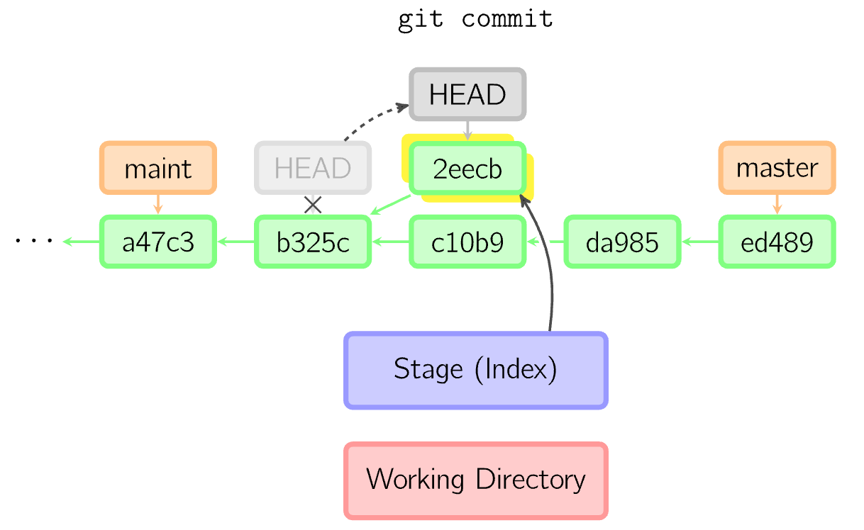
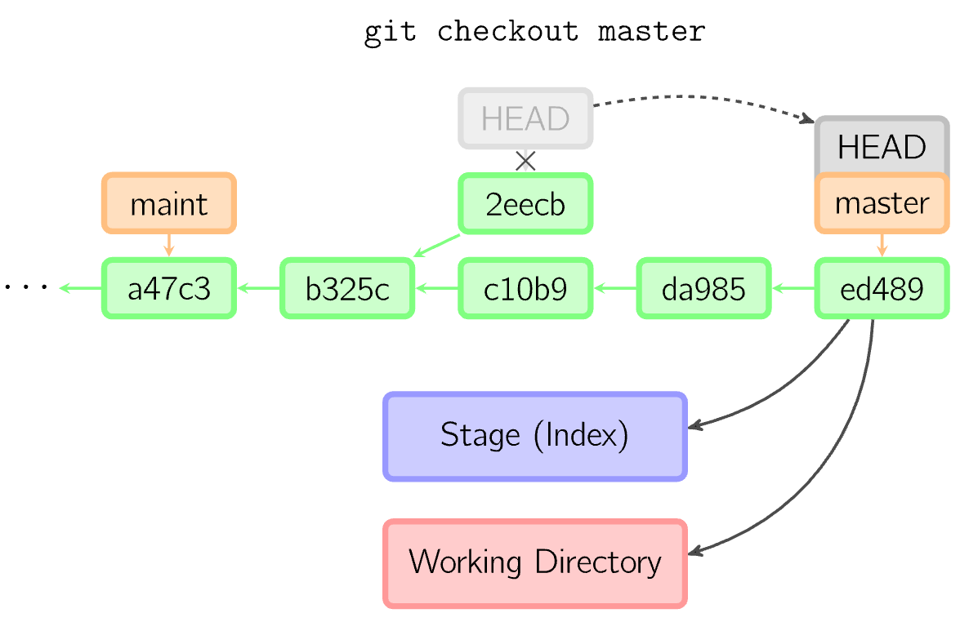
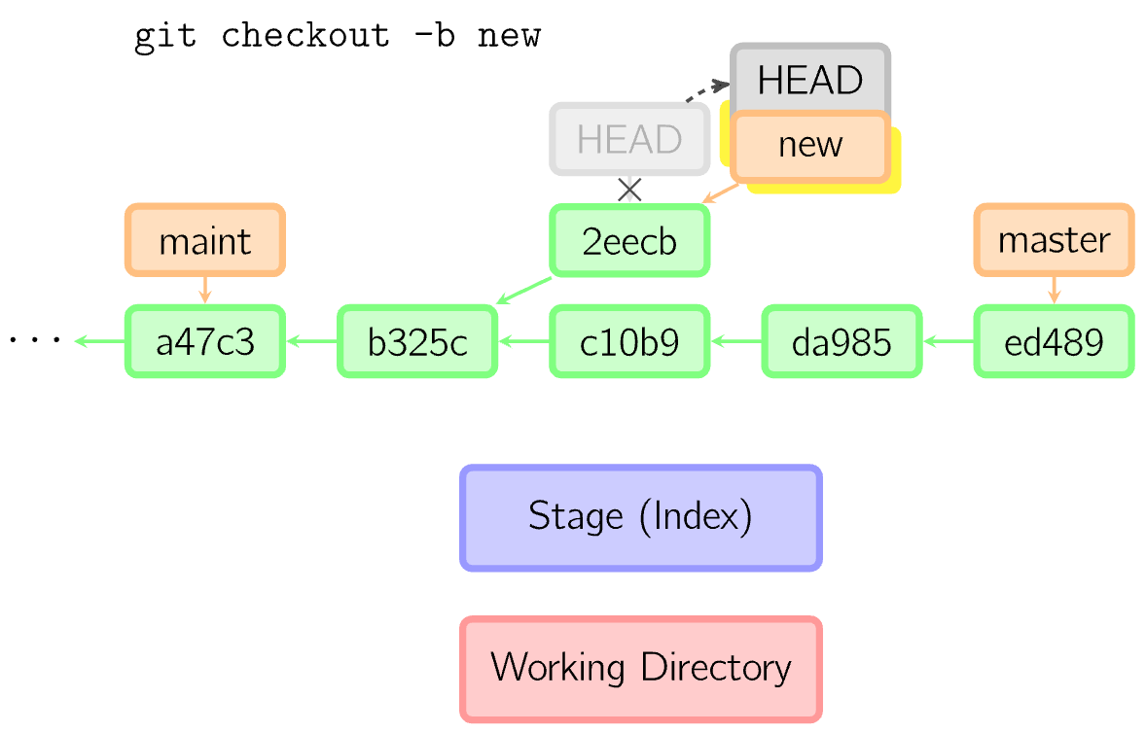
Commit with detached HEAD
Functions as a normal commit: a new commit-object is created, which the HEAD-reference points to
However, if another commit or branch is checked out, this commit is lost unless a new branch is created

Slide 30
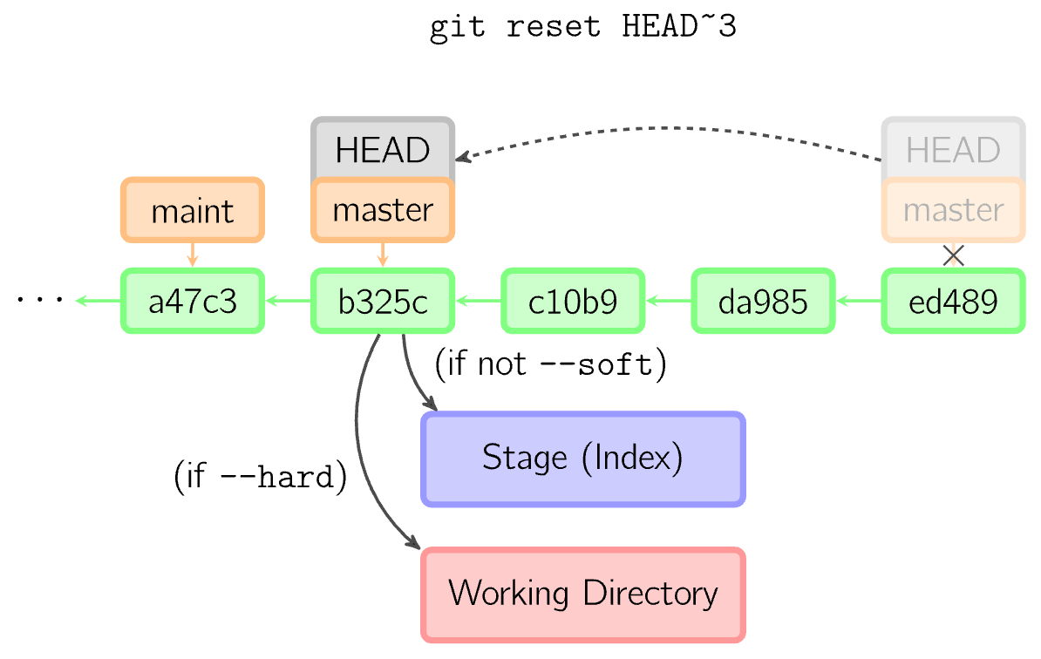
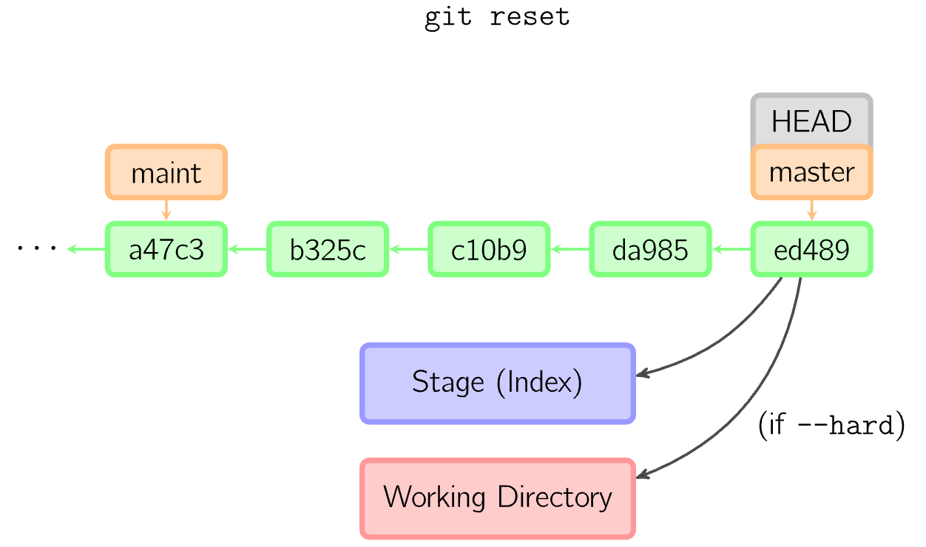
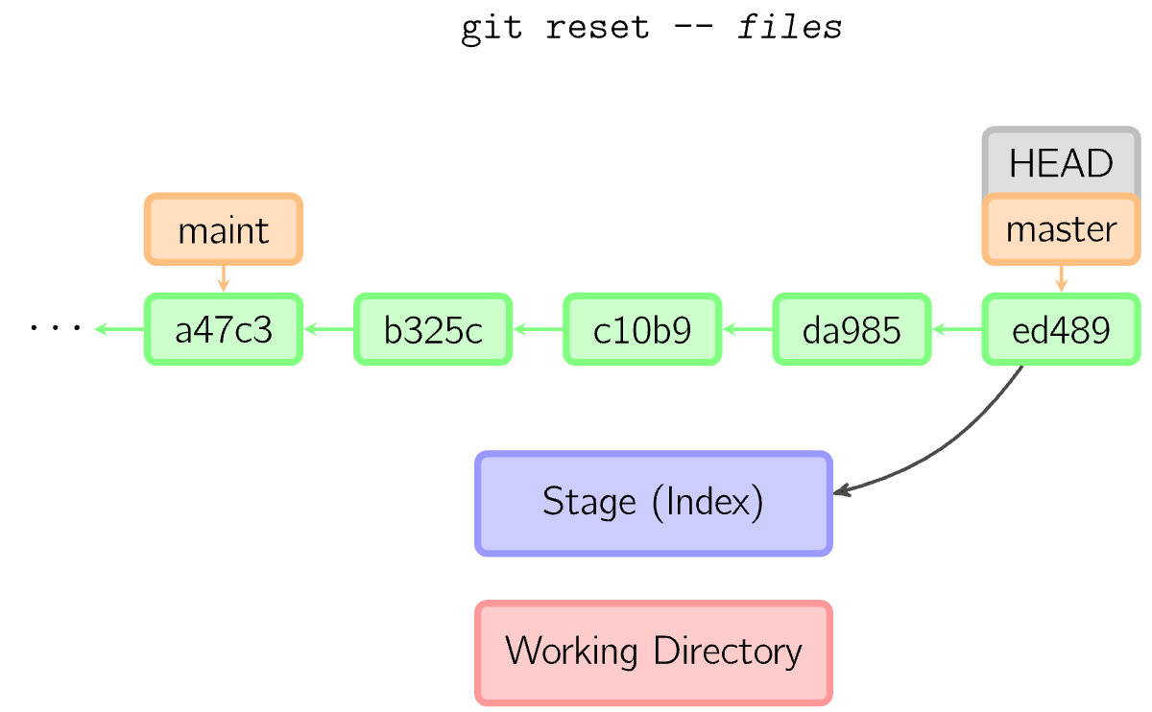
Shifting a branch - 1
With git reset Without specifying a file name, the current branch is moved to a different position, and the index (Staging area) is updated
Options: --hard: additionally updates the working directory --soft: neither the index nor the working directory is updated
If no commit is specified, HEAD is used; in this case, the branch is not moved, but only the index (and with --hard also the working directory) is updated
When a file name is specified, it behaves like a checkout, but only the index is updated

Slide 31
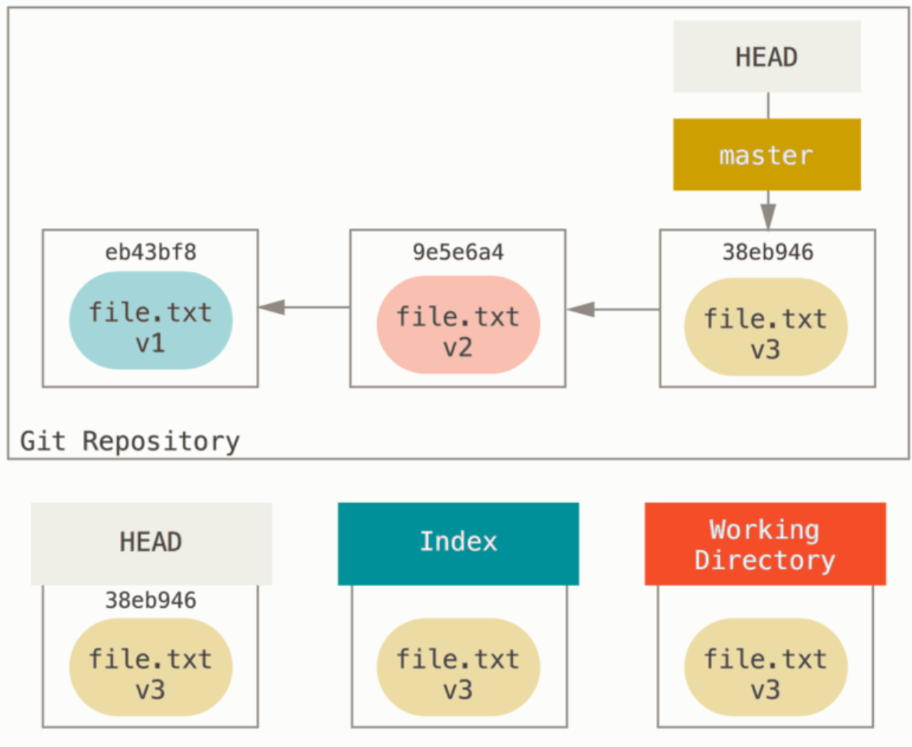
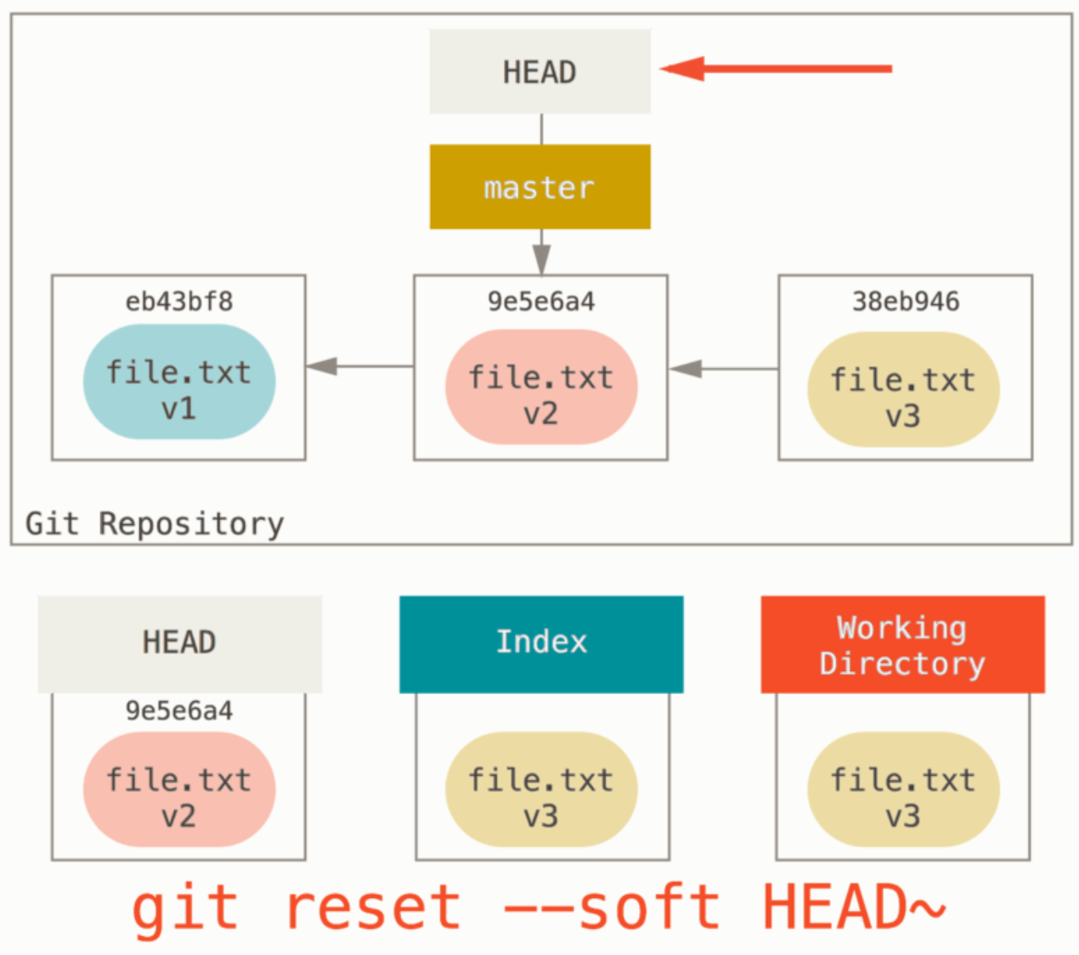
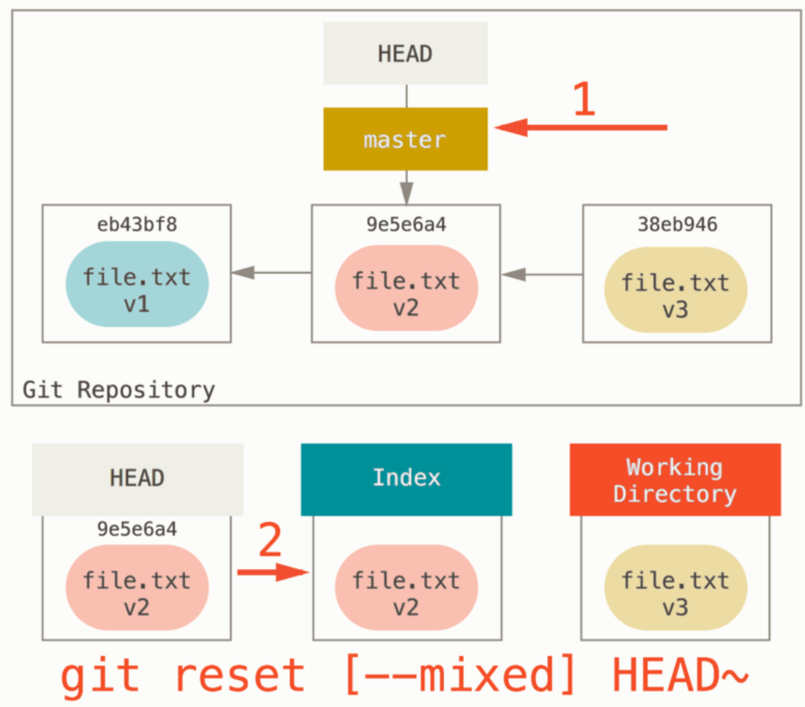
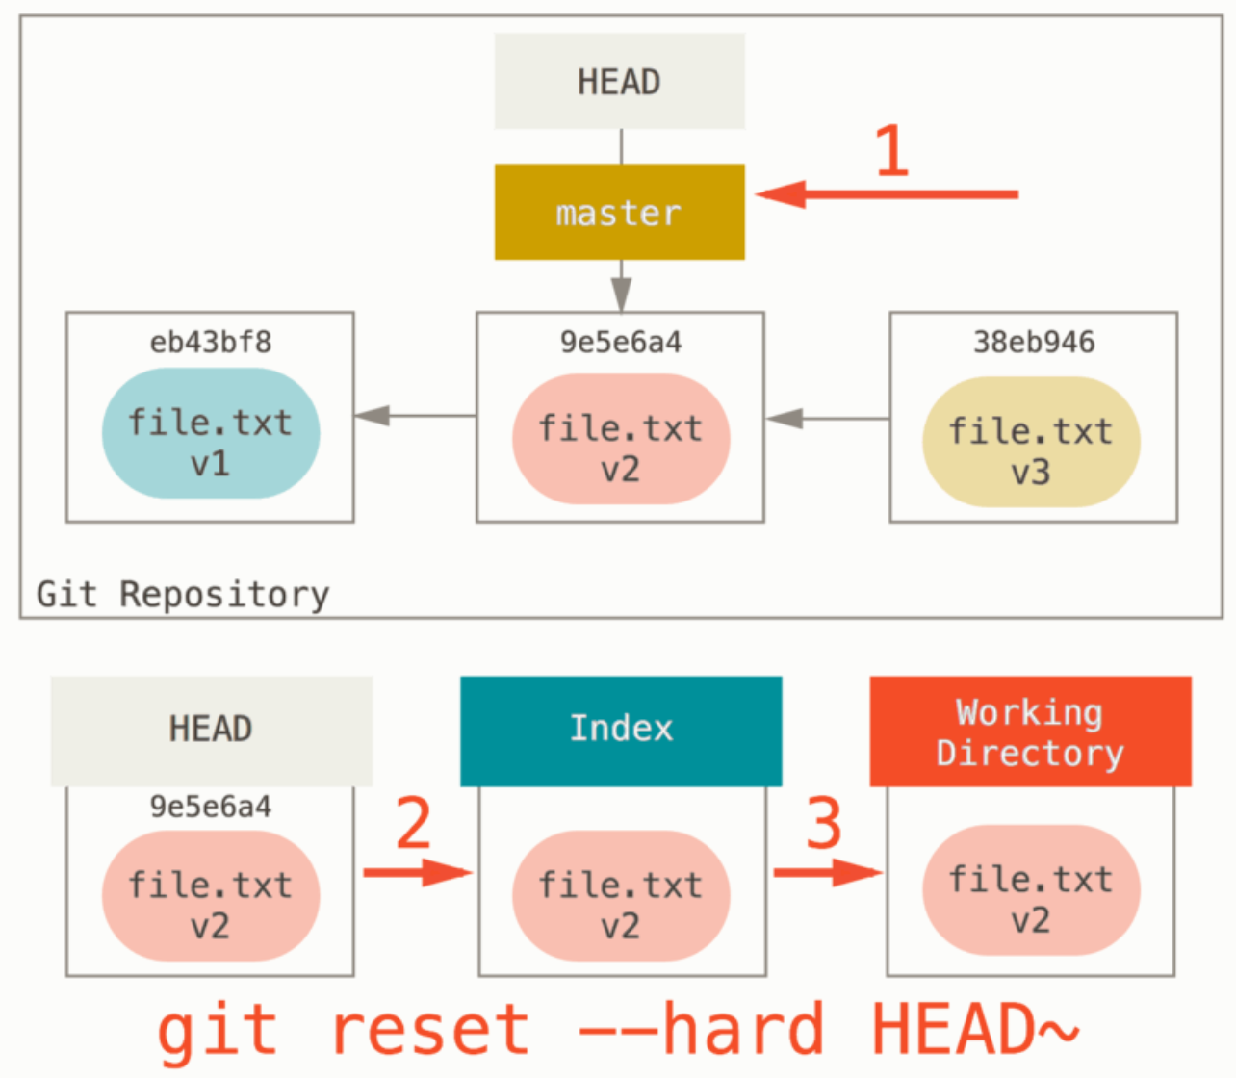
Shifting a Branch - 2

Slide 32
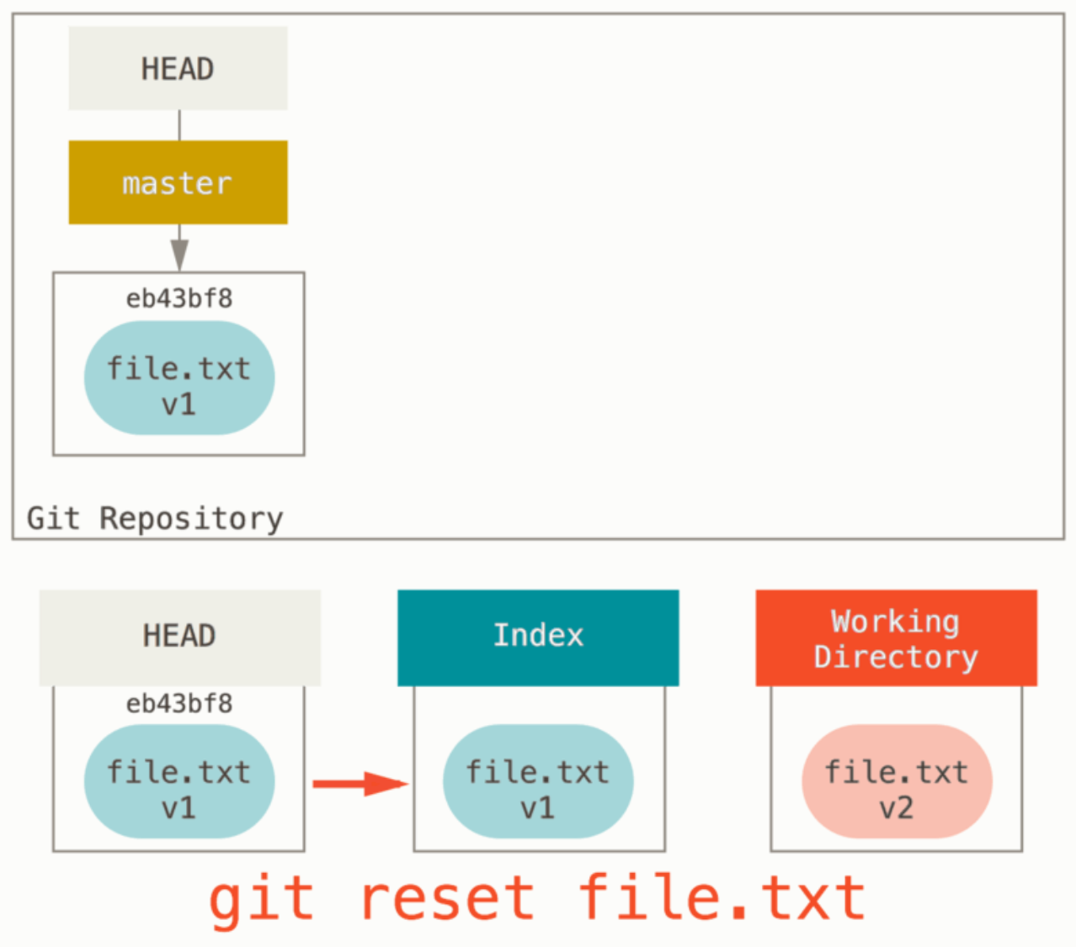
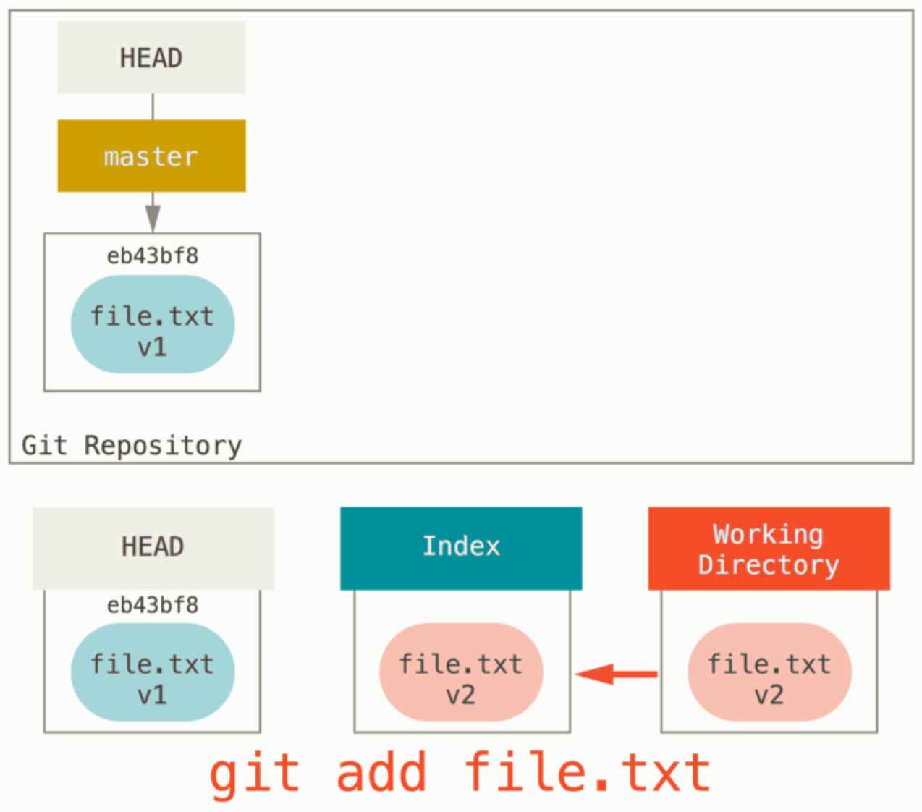
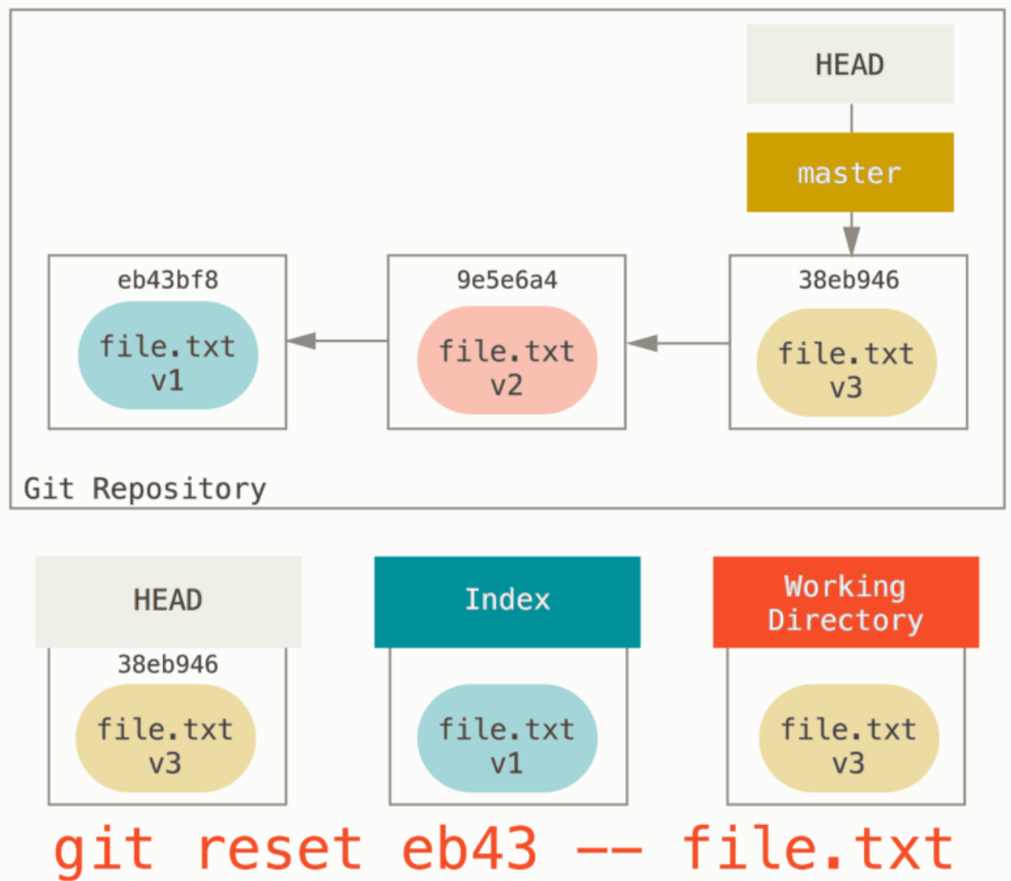
Reset with path
When a path is specified, git reset uses a branch at the head-reference
Unstaging Datei file.txt
Staging Datei file.txt
Staging Datei file.txt aus Commit

Slide 33
Merging Branches
Merge: merging different versions of data by synchronizing the changes
Result: Data that unifies all of the different version
The merging of different versions often happens automatically, but if changes are made to the same parts of a file, this results in a merge conflict that can only be resolved manually
git merge merges the changes of other commits with the current commit
Git automatically chooses a merge strategy when no explicit strategy is specified
Types of merge strategies
Explicit Merge: creates a new commit, in which the merged commits are visible
Implicit Merge: doesn’t create a new commit, but rather takes an amount of commits and uses these on a target branch (Rebase, Fast Forward Merge)
Squashed Merge: unifies the target branch’s commits and combines them into one commit
Notes:
Wikipedia englisch (Merge)
https://www.atlassian.com/git/tutorials/using-branches/merge-strategy

Slide 34
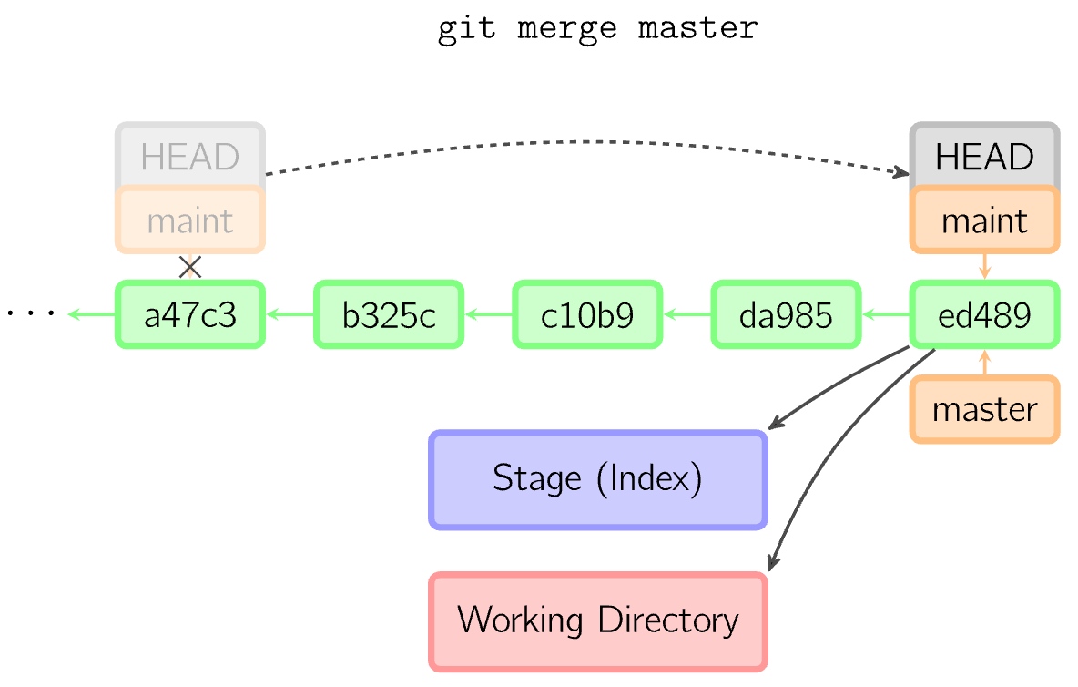
Fast Forward Merge
The commit that will be merged is the predecessor of the current commit. The current reference is moved onto another commit and then is checked out
Index must correspond to the current commit
No new commit is created

Slide 35
Merge Strategies
For the automatic merging of branches, there are different strategies in Git for changes that have been made on both sides of the merging branches
This includes determining the range of changes, moving ranges, determining, and whether the changes can be merged without conflicts
Strategies
Resolve
Recursive
Octopus
Ours
Subtree
Notes:
Silverman: Git Pocket Guide

Slide 36
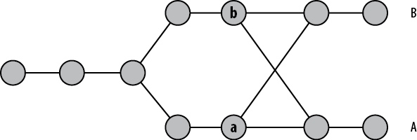
Merge Strategies – Resolve
Works with two branches that use the common predecessor as a basis for the merge
Uses 3-Way Merging
The changes from the “other branch” to the common predecessor are applied to the current branch
git merge –s resolve <branch1> <branch2>
Ambiguities with crisscross merge (no common predecessor)
Safe and fast
Crisscross Merge
Notes:
Loeliger und Cullough 2012: Version Control with Git
https://en.wikipedia.org/wiki/Merge_(version_control)#Three-way_merge

Slide 37
Merge Strategies – Recursive
Standard setting for pull or merge of two branches
Uses two branches
In the case that a common predecessor does not exist (crisscross merge), this strategy creates a virtual predecessor, in which the non-explicit predecessors are merged first
The temporary merge basis is deleted exclusively
Recognizes and resolves name changes, does not recognize copies
git merge –s recursive <branch1> <branch2>
Notes:
https://en.wikipedia.org/wiki/Merge_(version_control)#Three-way_merge

Slide 38
Merge Strategies – Options of Recursive
ours: prefers the changes of the current commit and overtakes the changes of other branch only when there are conflicts
theirs: prefers the changes of the commit that will be merged
patience: tries to avoid erroneous merges due to unimportant unmatching lies; advantageous if the branches diverge strongly
diff-algorithm: enables the specification of a diff-Algorithm
renormalize: merges check-out and check-in on all trees while a 3-way merge takes place; advantageous if the branches have different check-in/check-out states
no-normalize: avoids the renormalization operation
no-renames: ignores renamed data during the merge
find-renames=n: Default behavior: observes renaming of files; n: similarity
subtree: tries to match the paths of the two branches
Notes:
find-renames: Standard ist 100%

Slide 39
Merge Strategies – Octopus
Standard setting for more than two branches
Internally, the recursive merge strategy is called up several times, each time for a further branch.
git merge –s octopus <branch1> <branch2> ... <branch N>
Aborts in case of conflicts, whereby the state of the index and workspace can no longer be consistent
It is not possible to abort the merge with –abort
The changes can be discarded with git reset
Primarily used to merge similar feature branch commits in preparation for a release by merging all contributions
Instead of doing the merges individually, this can be done with Octopus in one go, whereby the commit history is cleaner and easier to understand
The individual branches should have already been synchronized with the master beforehand so that there are no more conflicts

Slide 40
Merge Strategies – Ours
git merge –s ours <branch1> <branch2> ... <branch N>
Merges multiple branches
Result is always a merge on the current HEAD branch
Changes to the current branch are retained, changes to the other branch discarded
The result is identical to the current HEAD branch, but all specified branches are now parent commits.
Used to combine the history of similar feature branches without transferring the changes of the other branches to the current branch

Slide 41
Merge Strategies – Subtree
git merge –s subtree <branch1> <branch2> (also adopts the history)
Extension of the Recursive-Strategy
In case a directory of a working directory is its own project
The child-commit is updated first, and it adopts the structure of the parent-commit
Likewise, the predecessor-commit of both branches is updated

Slide 42
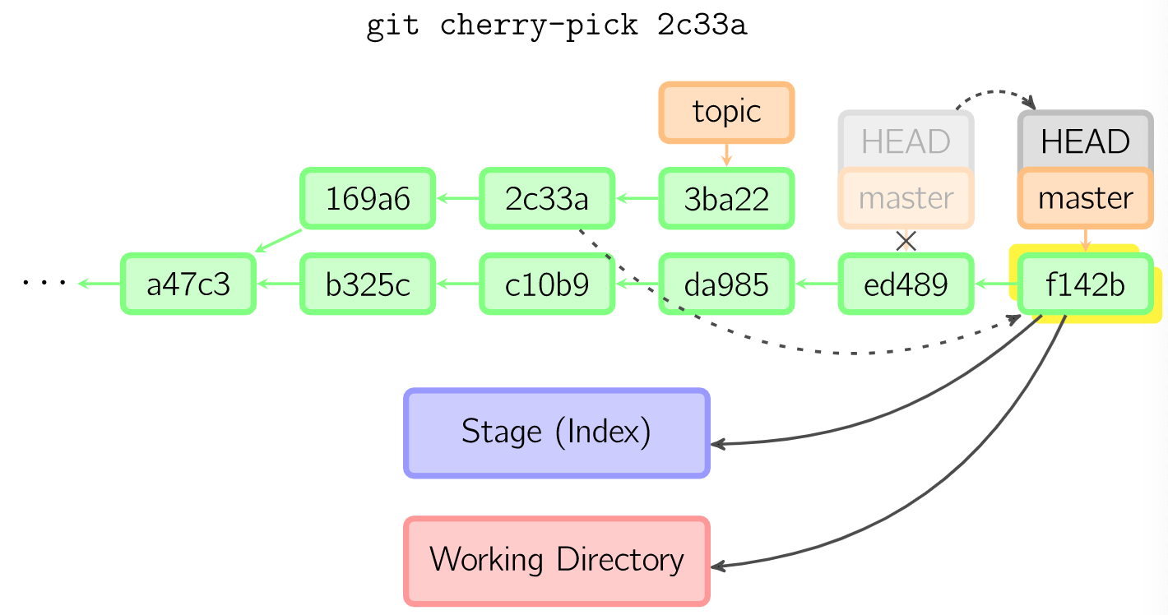
Cherry Pick
Copies a commit from one branch onto the current branch
Creates a new commit on the current branch with the same description and the same changes like in the original commit

Slide 43
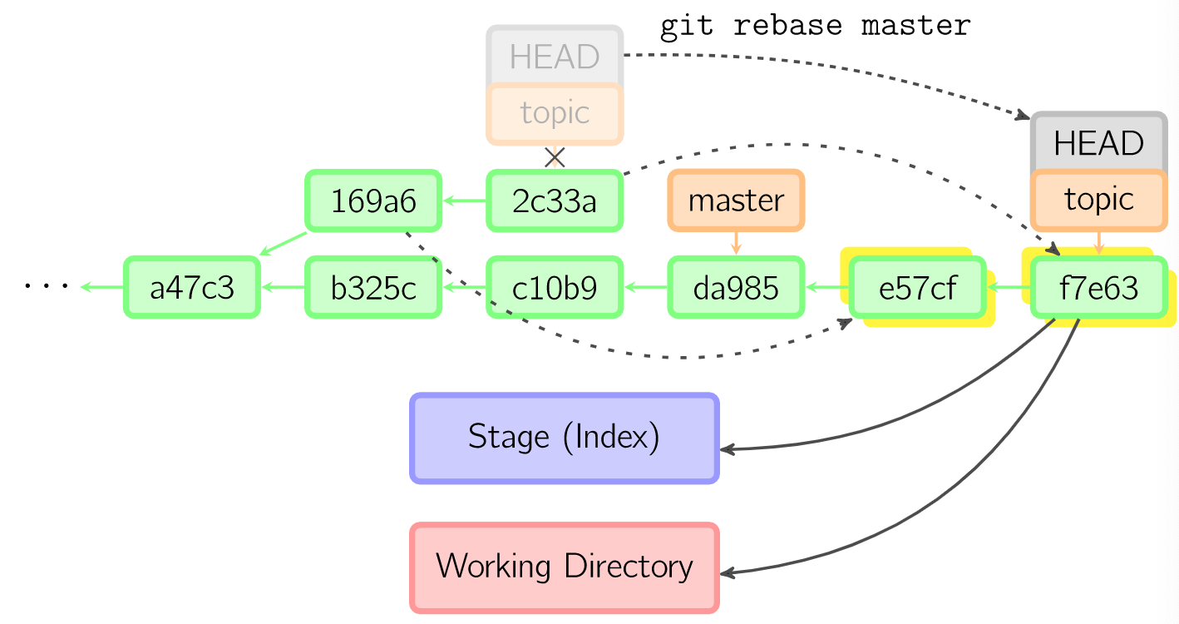
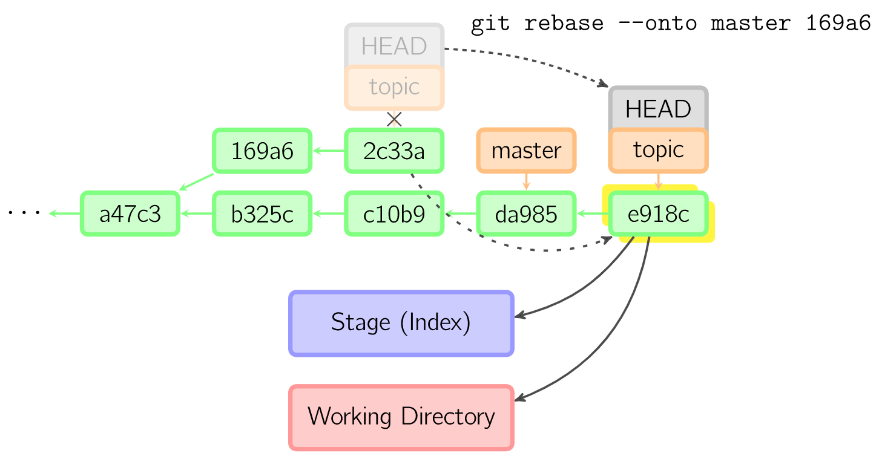
Rebasing
An alternative method to merge in order to merge branches
Commits of the current branch are hung on the end of another branch
Leads to a linear commit history (corresponds to an automated cherry pick of several commits)
The number of commits can be restricted with --onto <start commit ID>
Notes:
https://marklodato.github.io/visual-git-guide/index-de.html
Links:
Der obige Befehl nimmt alle Commits, die im Branch topic, aber nicht im Branch master existieren (169a6 und 2c33a), spielt diese auf den Branch master auf und verschiebt dann den Branch sowie den HEAD auf den zuletzt angehängten Commit. Beachte, dass danach nichts mehr auf die alten Commits verweist und diese gegebenenfalls von der Garbage Collection gelöscht werden.
Rechts:
Mit der Option --onto läßt sich einschränken, wie weit rebase beim Neuaufspielen zurückgehen soll. Das folgende Kommando hängt an den master die letzten Commits aus dem aktuellen Branch nach dem Commit 169a6 an (nur 2c33a).

Slide 44
Git Merge Policy
“Atlassian strongly prefers using explicit merges. The reason is very simple: explicit merges provide great traceability and context on the features being merged. A local history clean-up rebase before sharing a feature branch for review is absolutely encouraged, but this does not change the policy at all. It augments it.“
Notes:
https://www.atlassian.com/git/tutorials/using-branches/merge-strategy

Slide 45
Sources and Literature
Chacon, Scott und Ben Straub, 2014. Pro Git. 2. Auflage. Apress.
Laster, Brent, 2016. Professional Git. Wrox.
Loeliger, Jon und Matthew McCulough, 2012. Version Control with Git: Powerful tools and techniques for collaborative software development. 2. Auflage. O‘Reilly.
Preißel, René und Bjørn Stachmann, 2019. Git: Dezentrale Versionsverwaltung im Team – Grundlagen und Workflows. 5. Auflage. Dpunkt.verlag.

